Slide 1

Chicago Office Building
Tenant traffic Predictions

Slide 2

Machine Learning & Big Data
Team TAMA
Tejas Desai
Ankita Patel
Mamtha Sharma
Amy Peters

Slide 3
Tenant Traffic
Study tenant utilization to analyze trends and predict occupancy rates by hour to maximize efficiencies.
Building staffing – Security, Janitorial, Maintenance, Office Management
HVAC – Optimal Heating & Cooling
Lighting – Schedule or Sensor
Sustainability – Reduce Carbon Footprint

Slide 4
Data Zone
Dummy for testing
Sample for training
Created Database Tables & Merged
SQLite database for portability
Tables
Complete data extraction
Extraction to csv
Created CSV File
Timestamp of Card Swipe IN versus OUT
7 days a week
50 days
160,000 rows

Slide 5
Data
DATABASE
SQLite database for portability
Dummy data
Tables
Extraction to csv
Complete data extraction

Slide 6
Table structure
company
company_name
floors_from
event_id
door_id
compnay_id
floors_to
number_floors
event_log
door_id
door
company_id
event_date_time
door_name

Slide 7
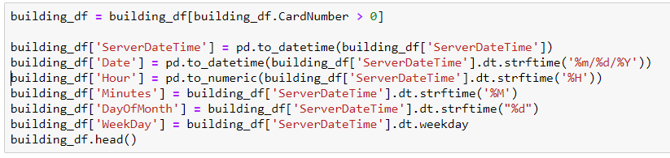
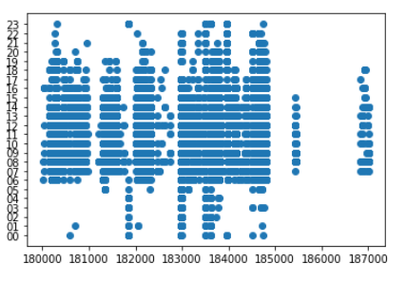
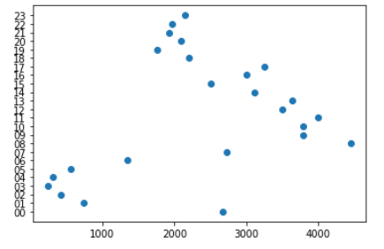
Data Ingestion: Methodology
Data cleanup
Removed all cards with a number 0
Convert dateTime to separate columns of DayOFMonth, DayOfWeek, Hour, etc.
Data Group
Group by Company
Group by DayOfMonth
Group by Hour
Group by CardNumber
Data visualizations
Line Chart
Bar Chart
Scatter plot

Slide 8
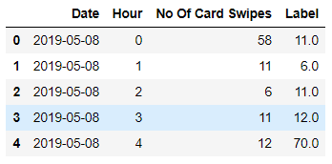
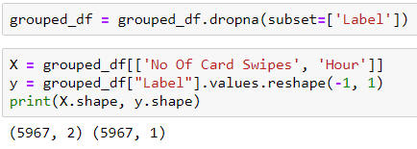
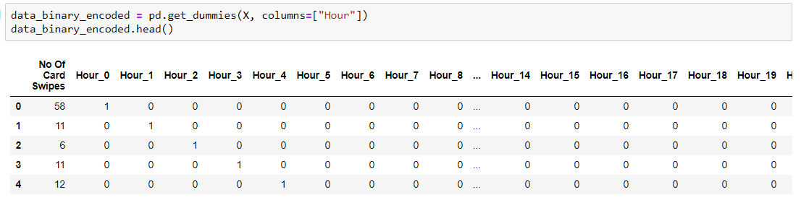
Data Transformation: Prepare for Machine Learning
Small Dataset
Filtered data by smallest number of card swipes
Filtered data by Companies
Data Label and Shifting
Added a column for No. of Card swipes per hour
Added Data lag to help with predication in ML model
Created dummy data for hours
Feature Extraction
By Companies
By Date
By Hours

Slide 9
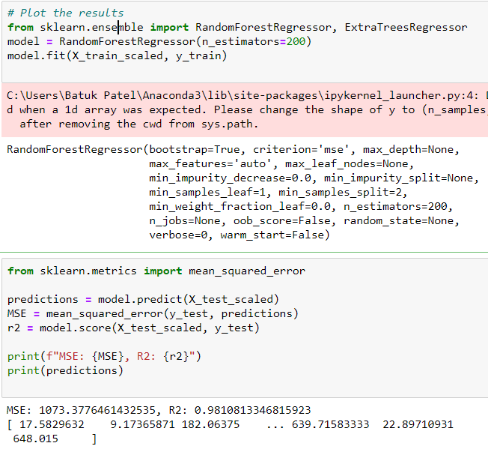
Machine Learning: Models and Predictions
What did not work
Linear Regression
KNN neighbors
What worked
Feature Extraction by hours
Model Training
Classification + Regression = Random Forest Trees
Outcomes
R2 ~= 0.98
Prediction of # of card swipes for next hour

Slide 10
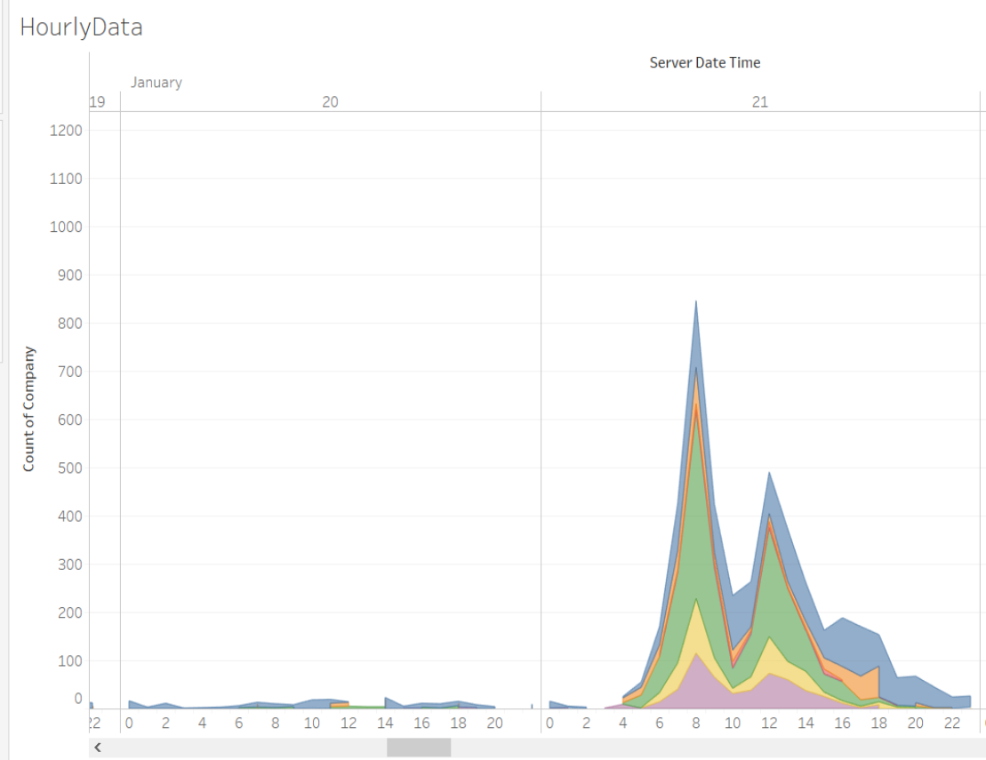
Hourly Data: Visualization
Jan 20, represents number of cards swiped on Sunday.
Jan 21, represents number of cards swiped on Monday.
As we can see there is vast difference between two which is expected.

Slide 11
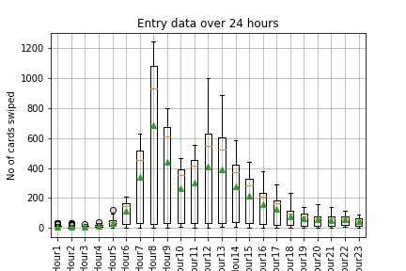
Box Plot: Entry Data Observations
We can see from the box plot during wee hours, cards swiped are very low and we get very narrow box plots.
From 6:00 am onwards cards swiped start going up, which is expected as people start showing up for work. Between 8:00 am and 9:00 am maximum cards are swiped.
You will again see spike in number of cards swiped around lunch time.
During busy hours you will see larger box plots and IQR, and median value higher then mean suggesting skewed distribution. This is due to the fact that less number of cards are swiped on weekend and holiday.

Slide 12
Good to have
Conclusions
To BE Continued
Through Machine Learning we can predict the number of people who are in the building within a given hour
Similar methodology could be used for other buildings in the vicinity
Data can be used to create “Intelligent” buildings
Avoid duplication/triplication of swipe-in data
Tie card number to company and floor
Capture swipe-out data
Predict occupancy by floor
Use predictions for control of the HVAC systems

